Slide 1
MSc Dissertation Proposal
Community Talks Project
Meet, Watch and Discuss
Event Host And Talk Provider Matching Project
Proposed By: | Robert Clifford (aka Bob)
Student Number: | 100339462
Institution: | University of East Anglia, Norwich, UK
School of Study: | Computing Sciences
Email and Mobile: | bob_clifford@email.com / 07811 289586
Date: | 16/12/2023

Slide 2
About the Project Proposer
Robert Clifford
Organiser of Basingstoke Science Café
Event host for monthly science talks by the Science Café since 2013
Research and booking of speakers for an audience of 1580+ subscribers
Organiser of venues, finances and diary of talk bookings
Member of the Association of Inter-Varsity Clubs
National UK network of social and sports clubs (Est. 1946 in London)
2,500 members in 28 clubs throughout England, Scotland and Wales
Officer at both National and Club level (Norwich and Basingstoke)
Organiser and host for many social and sporting events
Other Community Groups
Member and supporter of Skeptics in the Pub and Pint of Science
Member and supporter of Basingstoke Makerspace

Slide 3
The Problem Statement
Professor Bruce Hood at Bristol University had been running a web site called “Speakezee” for a number of years to help promote mostly academic in-person speakers to community and professional organisation talk organisers.
Professor Hood rebranded “Speakezee” to “ZoomTalks” at the start of the Covid-19 Pandemic in 2020 to provide livestream talks over the Internet.
The “ZoomTalks” site was shut down in late 2022 due to issues relating to obtaining financial support for the site and to allow Professor Hood to pursue his other academic interests.
The Problem to be solved …
There remains a need to provide a web based equivalent to ZoomTalks that assists the in-person speakers, online talk providers and event organisers to find each other based on their mutual interests.

Slide 4
The “Community Talks” Project
There are two sets of stakeholders whom this project aims to help:
Event Hosts – These are usually volunteers looking to fill a diary with in-person speakers and online talks for discussion by their group members. Any fees paid will depend on the kind of audience being catered for.
Talk Providers – These are people looking to deliver their own in-person speaker engagements plus livestream and recorded talk providers catering to a selected range of audiences. Any fees requested will depend on the kind of audience being catered for.
This project aims to develop a web application called “Community Talks” that can also be integrated with a wide range of social media and other apps.
The application and apps will aim to help event hosts and organisers be matched with suitable in-person speakers and online talk providers.

Slide 5
“Community Talks” Application
The Community Talks application:
An extension of the Agoria Community Engagement application.
Provide multiple searchable databases of Event Organisers and Hosts
Provide multiple searchable databases of in-person speakers and online talk providers
Provide multiple searchable databases of product and service providers
The Agoria system currently provides community engagement tools to many not-for-profit groups throughout England, Scotland and Wales.
History of the Agoria System
2001 – Created as a hierarchical sub-group membership system for Basingstoke IVC
2002 – Modified to a scale-free member and group system for the UK Rugby Football Union to manage 500,000 members in over 1,700 clubs
2010 – Extended to add e-commerce facilities to support fund raising activities by a number of UK based charities
2012 – Agoria front-end web site builder and other tools added to create a community engagement application
2022 – Creation of the first Community Talks database tools to enhance the use of Agoria as a Community Engagement application

Slide 6
“Community Talks” Appendix
Screen shots from applications
mentioned in this proposal
Zoom Talks and Agoria

Slide 7
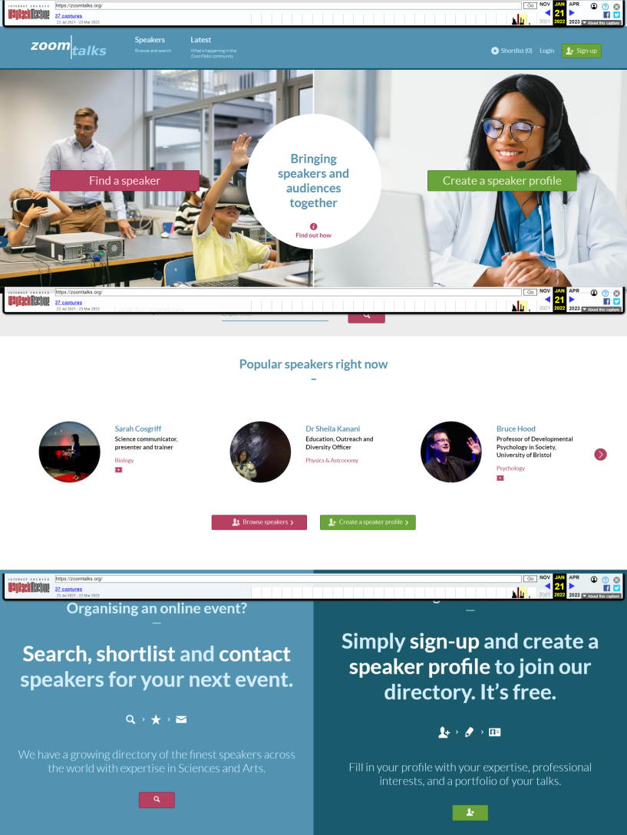
ZoomTalks
An example talk providers promotion web site

Slide 8
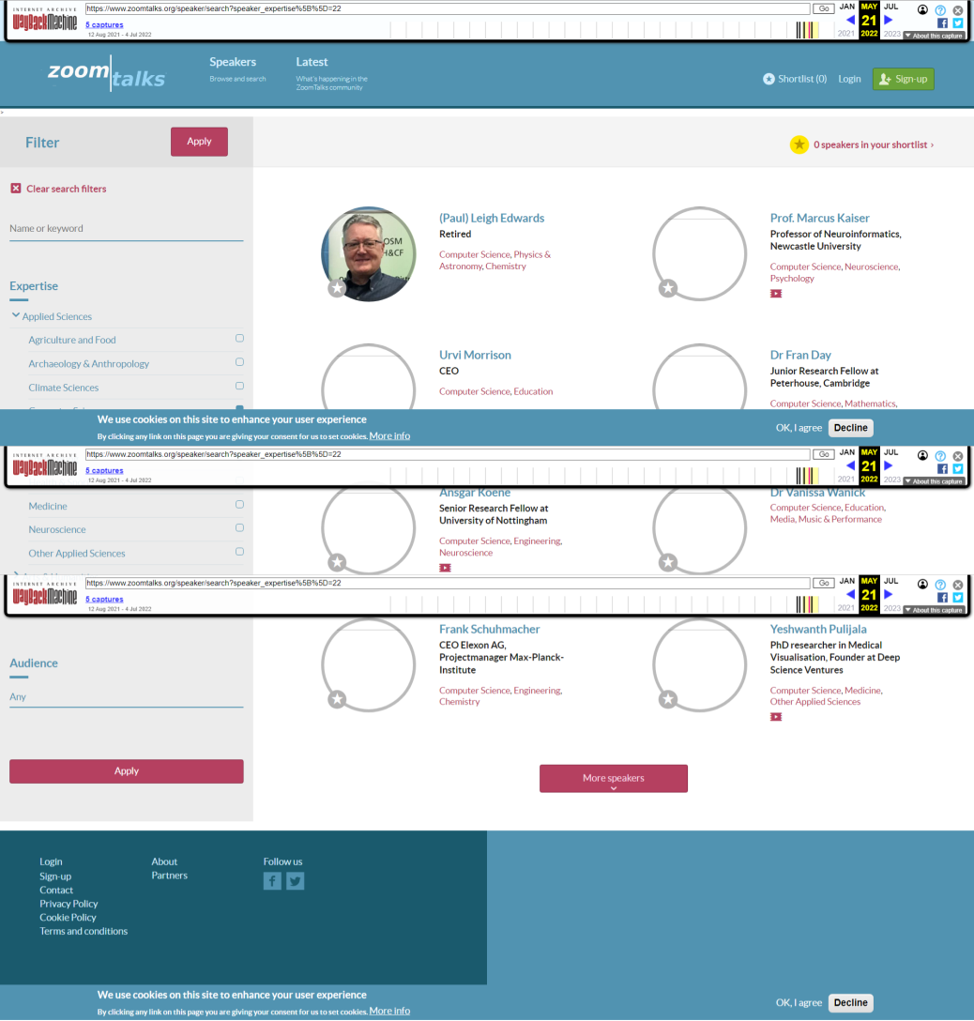
ZoomTalks
The talk providers list

Slide 9
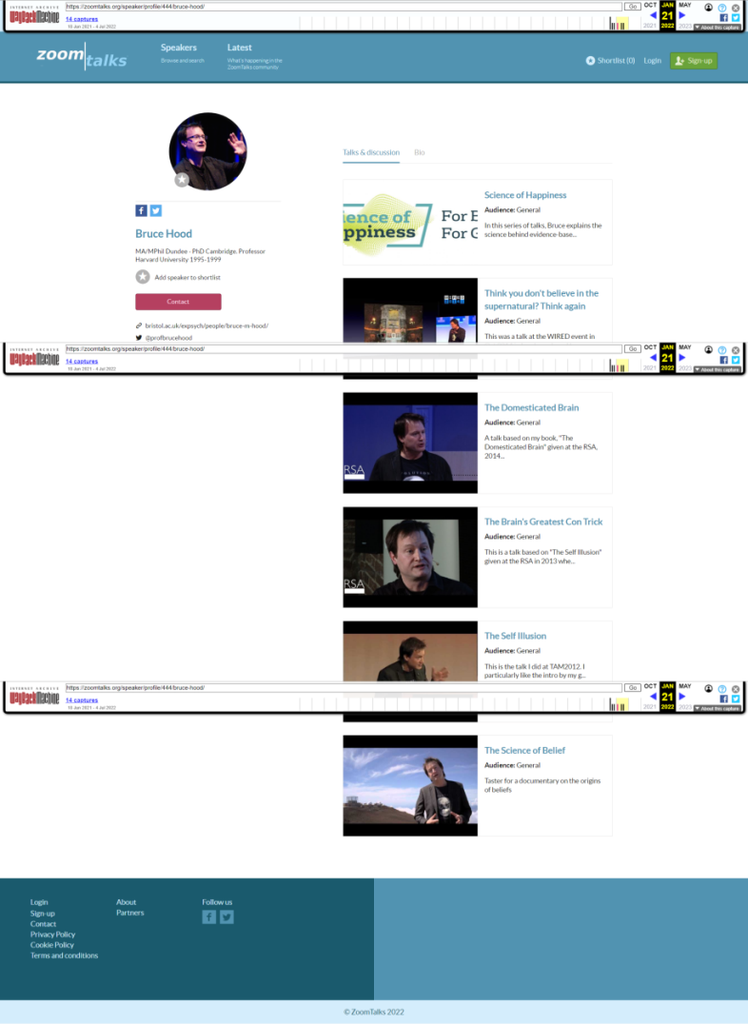
ZoomTalks
An example talk provider - Professor Bruce Hood

Slide 10
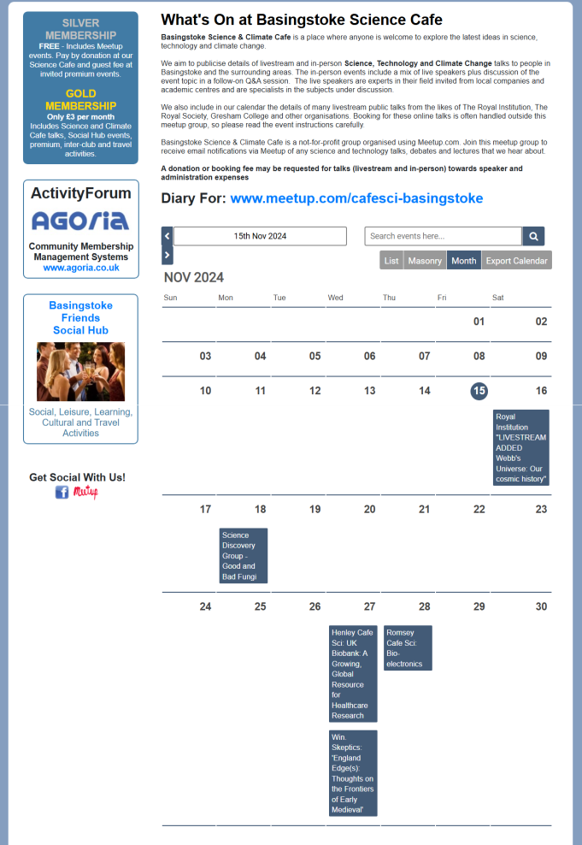
Agoria Community Engagement
Social and Talk Event Calendar
Calendar of all events including in-person. livestream and recorded talks for discussion

Slide 11
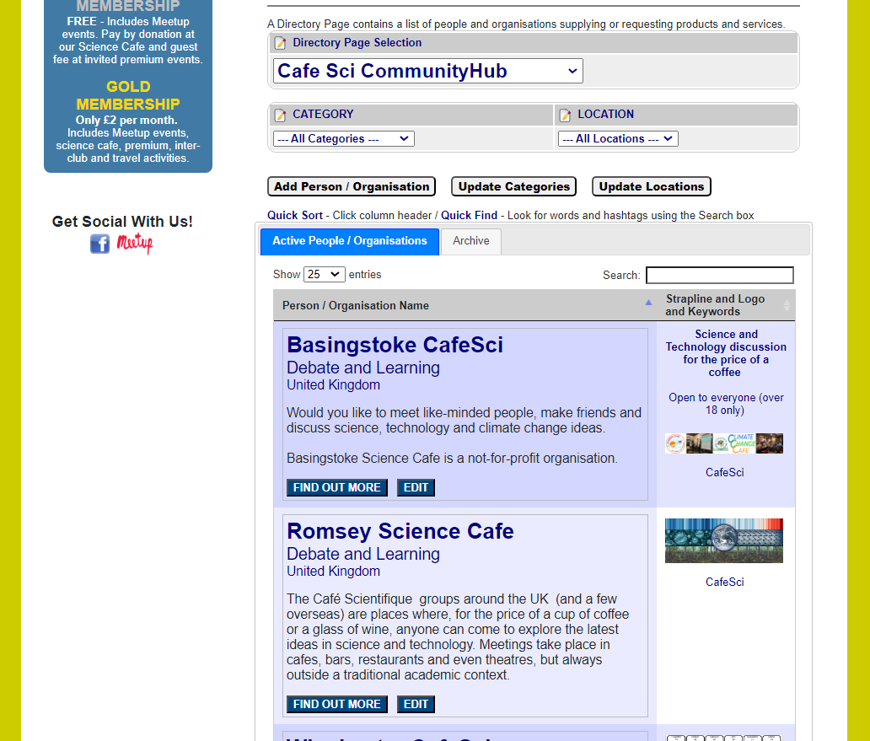
Agoria Community Engagement
Talk Provider and Event Host Databases
List of in-person, livestream and recorded talks providers and hosts

Slide 12
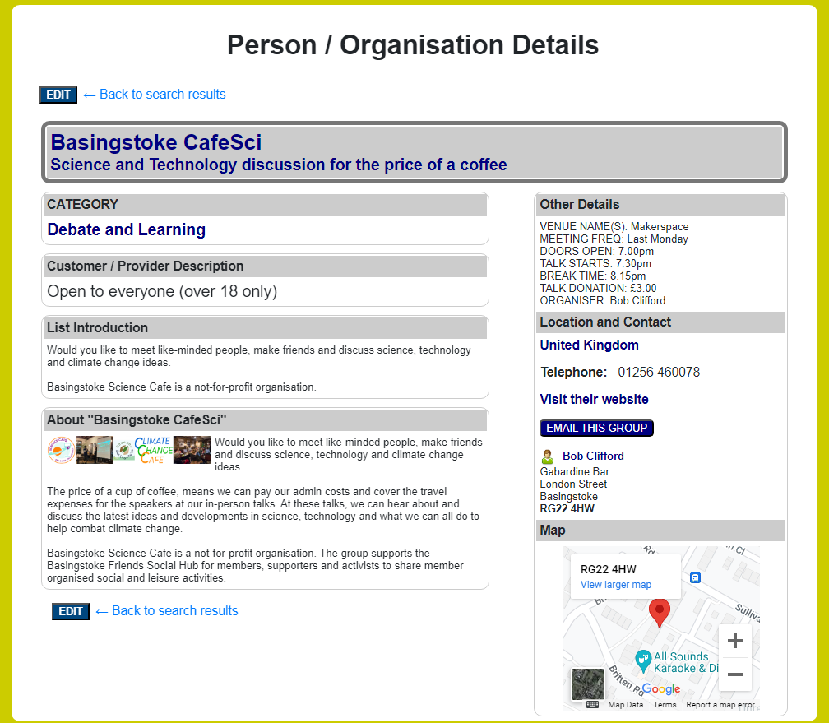
Agoria Community Engagement
Talk Provider and Host Description Entries
Description details for in-person, livestream and recorded talks providers and hosts

Slide 13
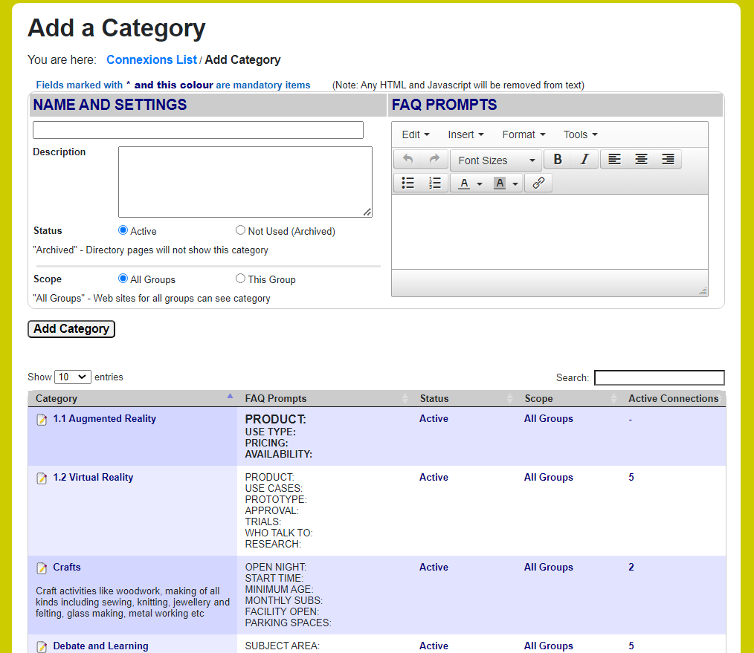
Agoria Community Engagement
Talk Host and Provider Category Database
Search categories for in-person, livestream and recorded talk providers and hosts

Slide 14
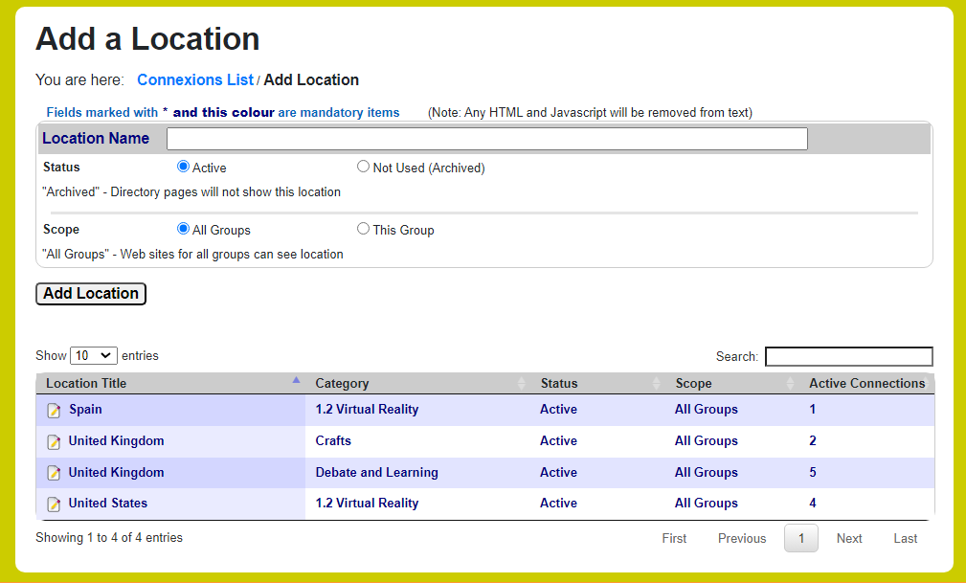
Agoria Community Engagement
Talk Provider and Host Location Database
Search locations for in-person, livestream and recorded talk providers and hosts

Slide 15

Agoria Community Engagement
Contact Details
Connect, Collaborate and Innovate
www.communityhub.co.uk
www.agoria.co.uk
Contact us to explore the opportunities for your community:
roger@activityforum.co.uk or bob@activityforum.co.uk
Business Director
Development Director
roger@activityforum.co.uk Call to explore opportunities +44(0)7710 920 373

